Slide 1
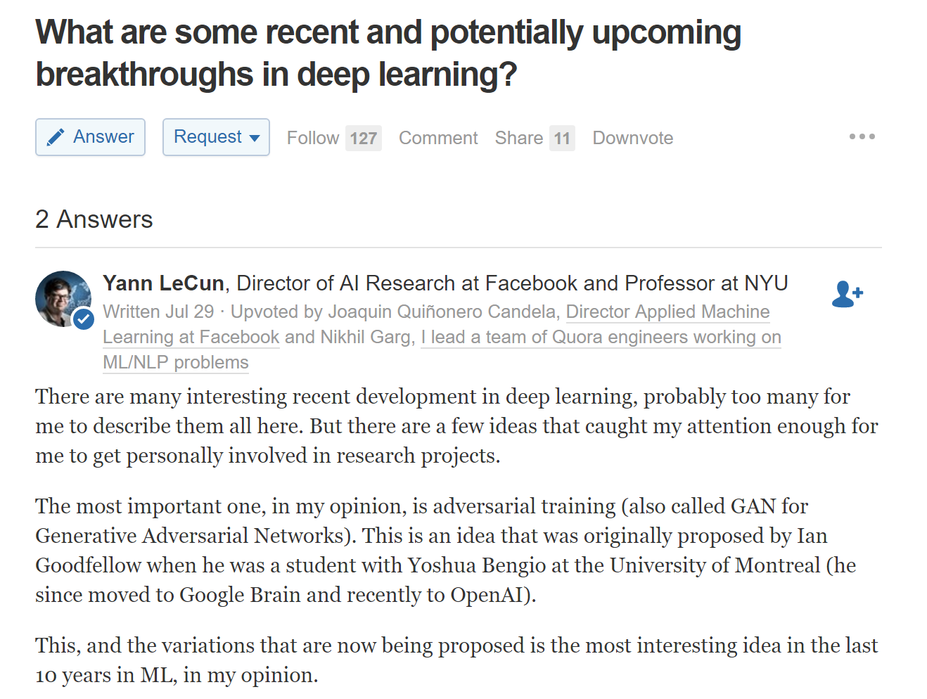
Generative Adversarial Network

Slide 2
Generative Adversarial Network
Goodfellow et al. "Generative adversarial nets." Advances in Neural Information Processing Systems. 2014.
Radford et al. "Unsupervised representation learning with deep convolutional generative adversarial networks." ICLR, 2015
Reed et al. "Generative adversarial text to image synthesis." ICML, 2016
Yoo et al. "Pixel-Level Domain Transfer." ECCV, 2016
Isola et al. "Image-to-Image Translation with Conditional Adversarial Networks." arXiv ,2016
Nguyen et al. "Plug & Play Generative Networks: Conditional Iterative Generation of Images in Latent Space." arXiv ,2016

Slide 3
Slide credit: Sangdoo Yun @PIL (pil.snu.ac.kr)
Generative Adversarial Network, NIPS 2014
Ian J. Goodfellow, Jean Pouget-Abadie, Mehdi Mirza, Bing Xu, David Warde-Farley, Sherjil Ozair, Aaron Courville, Yoshua Bengio

Slide 4
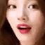

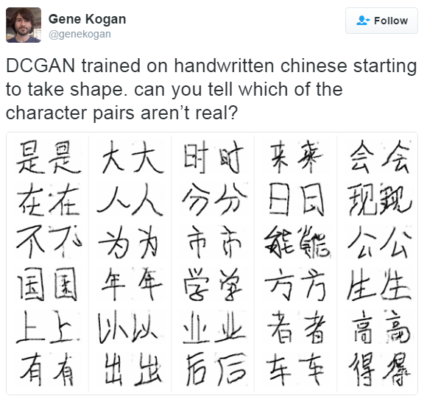



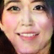

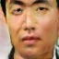
Turing Test

Slide 5
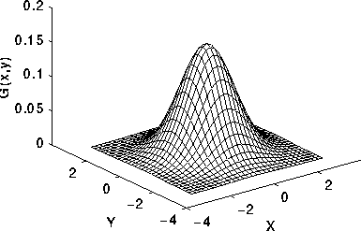
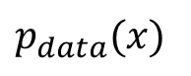
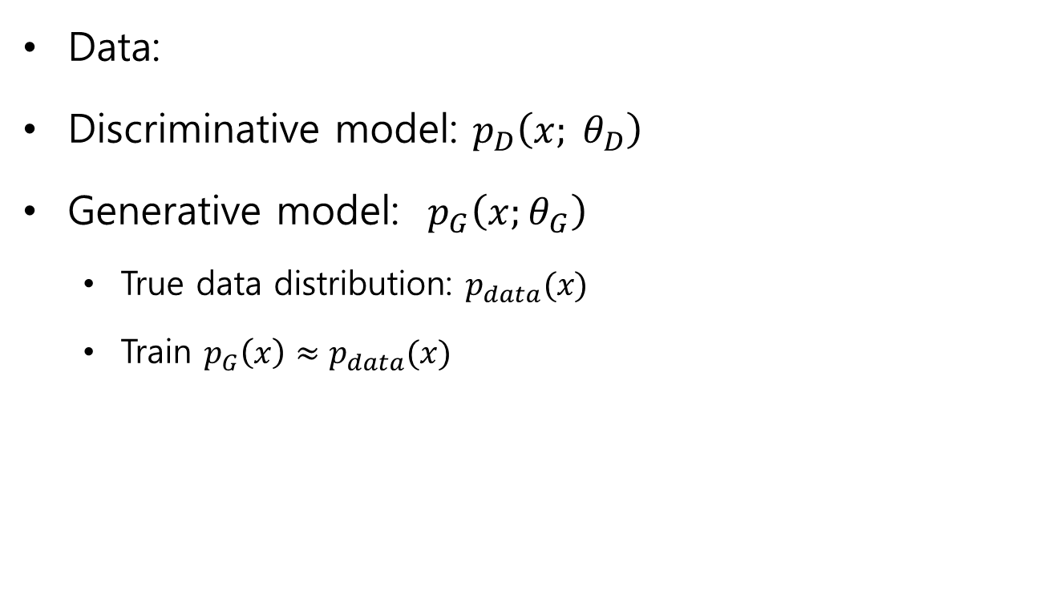
Generative?
…
Data:
Discriminative model: $p_{D}\left(x; θ_{D}\right)$
Generative model: $p_{G}\left(x;θ_{G}\right)$
True data distribution: $p_{data}(x)$
Train $p_{G}\left(x\right)≈p_{data}(x)$
$p_{data}(x)$

Slide 6





Generative Adversarial Network
Counterfeiters vs Police Game
IT’S FAKE MONEY!
IT’S REAL MONEY!

Slide 7
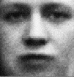

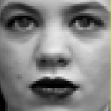

Generative Adversarial Network
Discriminative Model D
Generative Model G
…
…
…
…
…
…
p(z)
…
…
Sample x
Random noise z

Slide 8
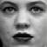

Generative Adversarial Network
Discriminative Model D
Try to classify the sample x
D(x)=0 when x from Data
D(x)=1 when x from G (generator)
1
0
…
…
Differentiable function represented by a multilayer perceptron with parameters
…
…
…
…
sample x
from data
sample x
from G
…
Generative Model G
…
Try to generate sample x
As similar as the real data
…
p(z)
…
random noise z
…

Slide 9
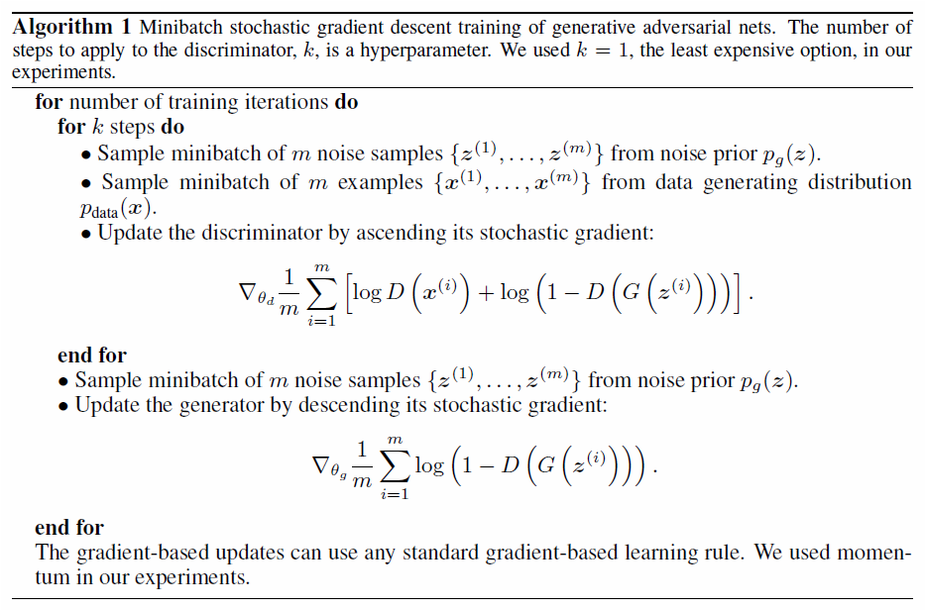


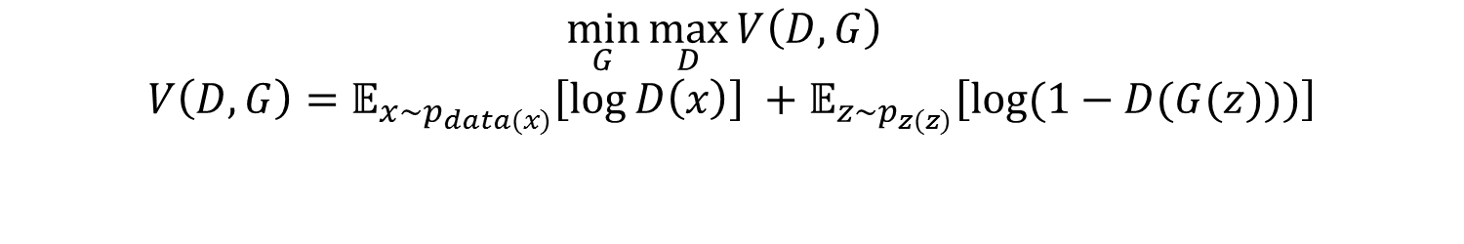
Generative Adversarial Network
$$\min_{G}{\max_{D}{V\left(D,G\right) }}$$
$$V\left(D,G\right)=𝔼_{x\sim p_{data(x)}}\left[\log{D\left(x\right)}\right] +𝔼_{z\sim p_{z(z)}}\left[\log{(1−D(G(z)))}\right]$$
Discriminative Model D
1
0
…
…
…
…
…
…
…
Generative Model G
…
…
…
p(z)
random noise z
…

Slide 10
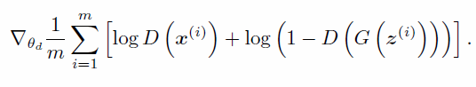
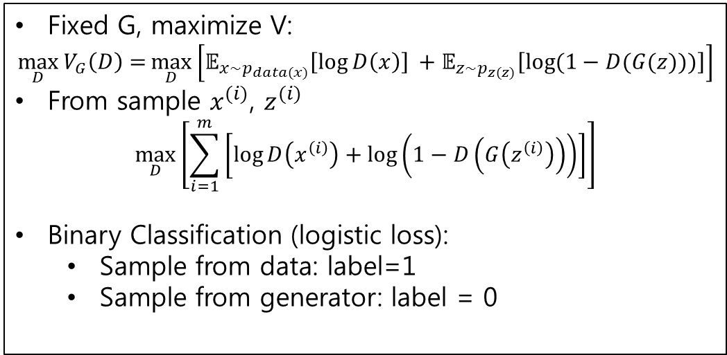
Generative Adversarial Network
$$\min_{G}{\max_{D}{V\left(D,G\right) }}$$
$$V\left(D,G\right)=𝔼_{x\sim p_{data(x)}}\left[\log{D\left(x\right)}\right] +𝔼_{z\sim p_{z(z)}}\left[\log{(1−D(G(z)))}\right]$$
Fixed G, maximize V:
$$\max_{D}{V_{G}\left(D\right)=}\max_{D}\left[𝔼_{x\sim p_{data(x)}}\left[\log{D\left(x\right)}\right] +𝔼_{z\sim p_{z(z)}}\left[\log{(1−D(G(z)))}\right]\right]$$
From sample $x^{(i)}$, $z^{(i)}$
$$\max_{D}\left[\sum_{i=1}^{m}{\left[\log{D\left(x^{\left(i\right)}\right)+\log\left(1−D\left(G\left(z^{\left(i\right)}\right)\right)\right)}\right]}\right]$$
Binary Classification (logistic loss):
Sample from data: label=1
Sample from generator: label = 0
Discriminative Model D
1
0
…
…
…
…
…
…
…
Generative Model G
…
Stochastic Gradient
…
…
p(z)
random noise z
…

Slide 11
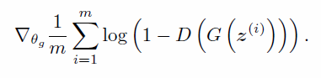
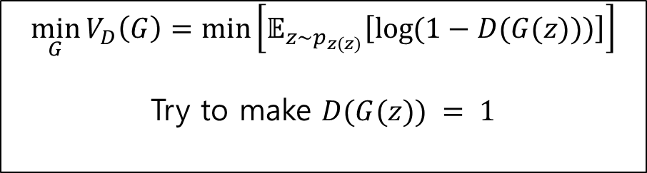
Generative Adversarial Network
$$\min_{G}{\max_{D}{V\left(D,G\right) }}$$
$$V\left(D,G\right)=𝔼_{x\sim p_{data(x)}}\left[\log{D\left(x\right)}\right] +𝔼_{z\sim p_{z(z)}}\left[\log{(1−D(G(z)))}\right]$$
Discriminative Model D
Fixed D, minimize V(G):
1
0
$$\min_{G}{V_{D}\left(G\right)=\min\left[𝔼_{z\sim p_{z(z)}}\left[\log{(1−D(G(z)))}\right]\right]}$$
Try to make $D(G(z)) = 1$
…
…
…
…
…
…
…
Stochastic Gradient
Generative Model G
…
…
…
p(z)
random noise z
…

Slide 12
Generative Adversarial Network
Update D
Update G

Slide 13
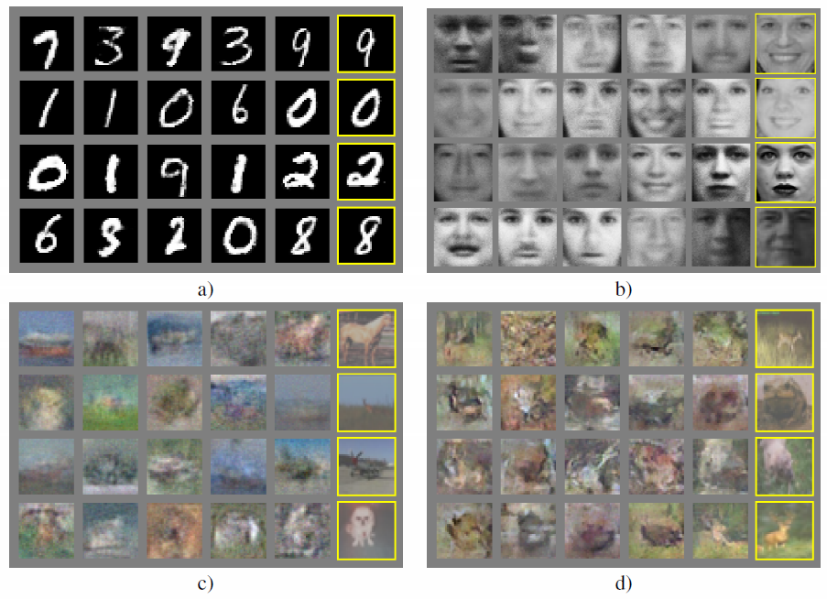
GAN Results
Nearest training example
Generated Samples

Slide 14
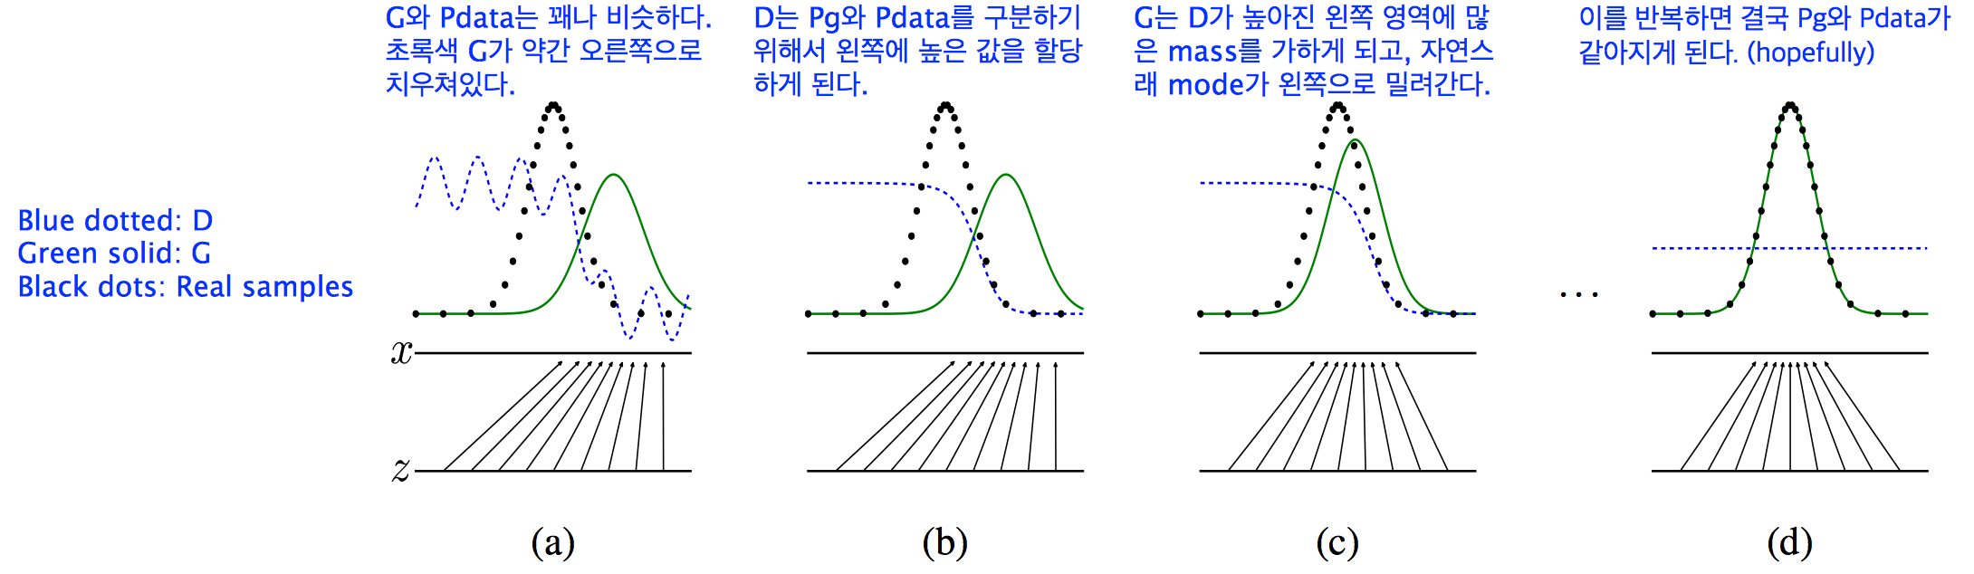
How It Works

Slide 15
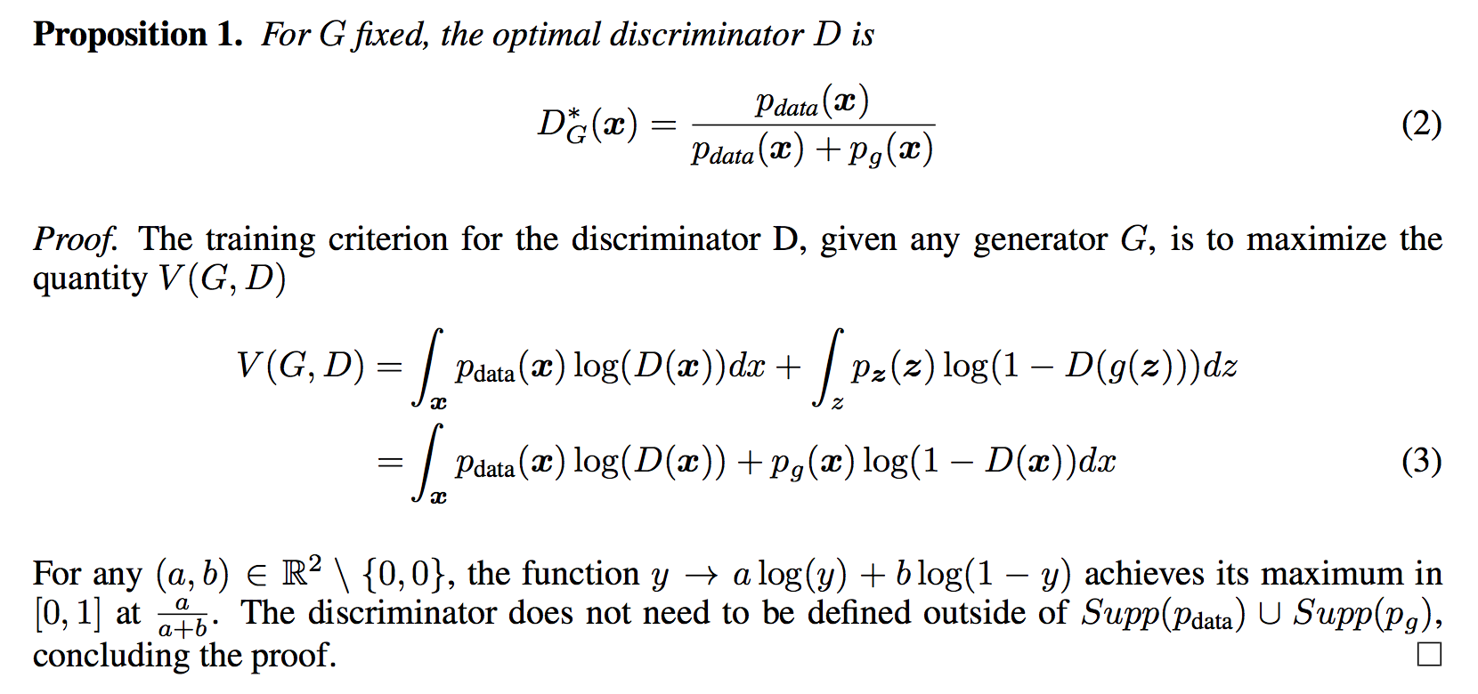
Some Theoretical Results

Slide 16
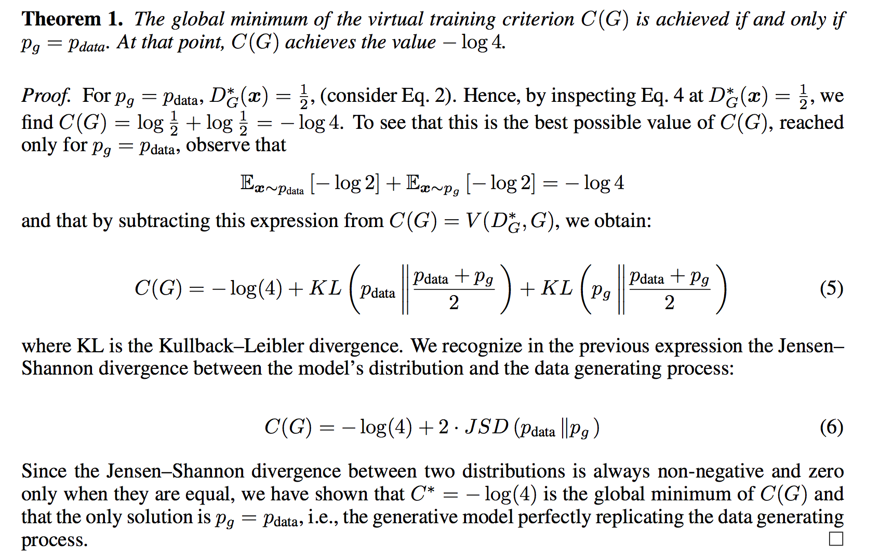
Some Theoretical Results

Slide 17
Unsupervised Representation Learning with Deep Convolutional Generative Adversarial Network, ICLR 2016.
Slide credit: Sangdoo Yun @PIL (pil.snu.ac.kr)
Alec Radford, Luke Metz and Soumith Chintala

Slide 18
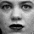

DCGAN
Deep Convolutional Network + GAN
Tricks for stable training
Experimental Analysis
Discriminative Model D
1
0
…
…
…
…
…
…
…
Generative Model G
…
…
…
p(z)
random noise z
…

Slide 19


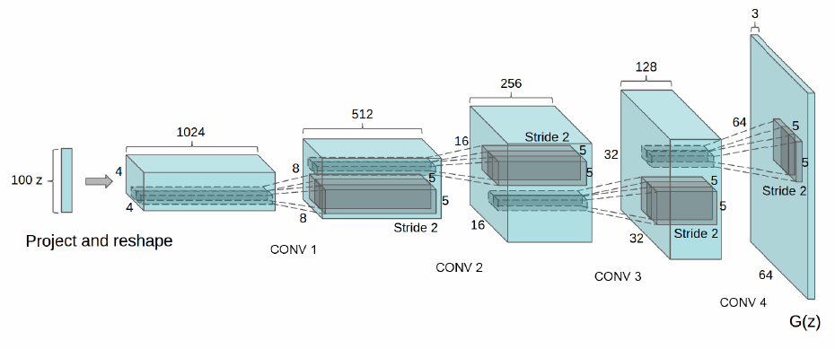
DCGAN
Discriminative Model D
1
0
…
…
…
…
…
…
Replace model’s network to CNN
Example of generator G
(same as D)
…
Generative Model G
…
…
…
p(z)
random noise z
…
z: uniform dist.

Slide 20
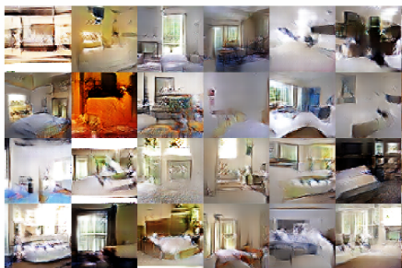
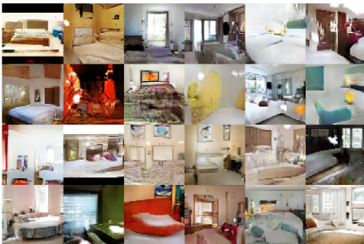
Experiments
LSUN – bedroom dataset
3 million training examples
Epoch #1
Epoch #5

Slide 21
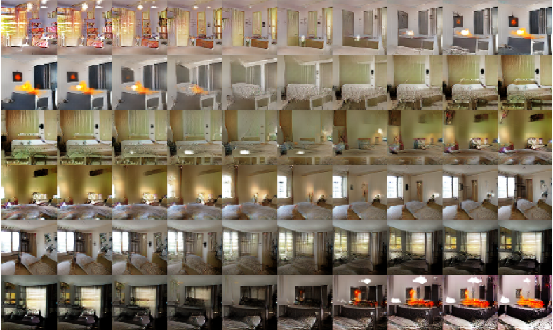
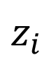
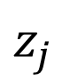
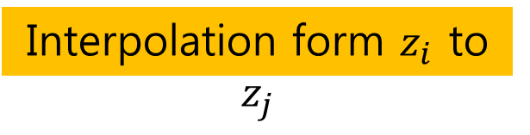
Experiments
Input noise z
Interpolation form $z_{i}$ to $z_{j}$
$$z_{i}$$
$$z_{j}$$

Slide 22
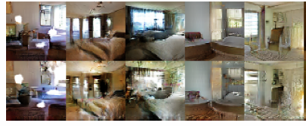
Experiments
Which activations(feature map) in CNN has representation of ‘window’?
At feature activations, assign neuron in the window region is 1, otherwise 0.
Logistic regression to find window-representative feature map.
Window feature map removal

Slide 23
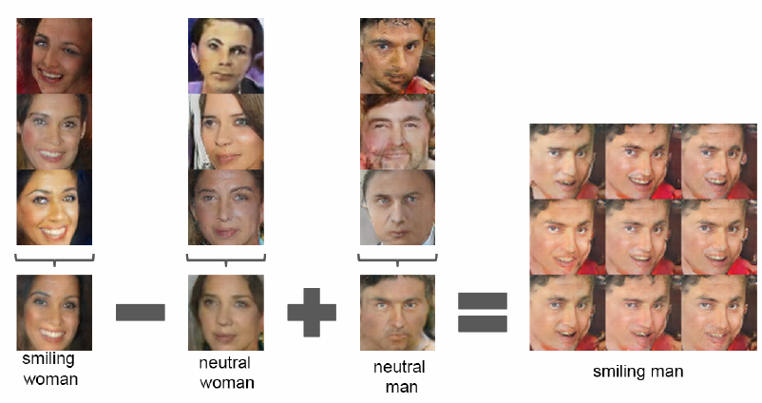
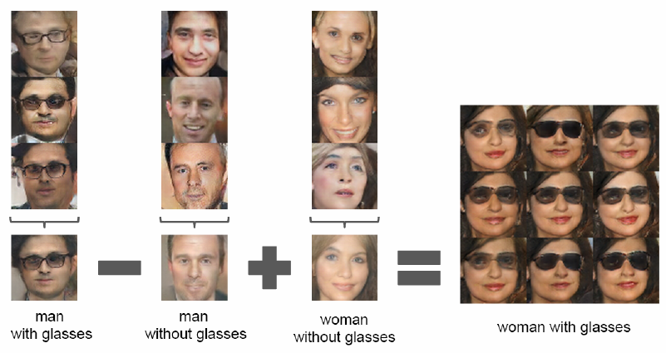
Experiments
Faces – scraped human face image from web
3 million images from 10,000 people.
Vector arithmetic

Slide 24
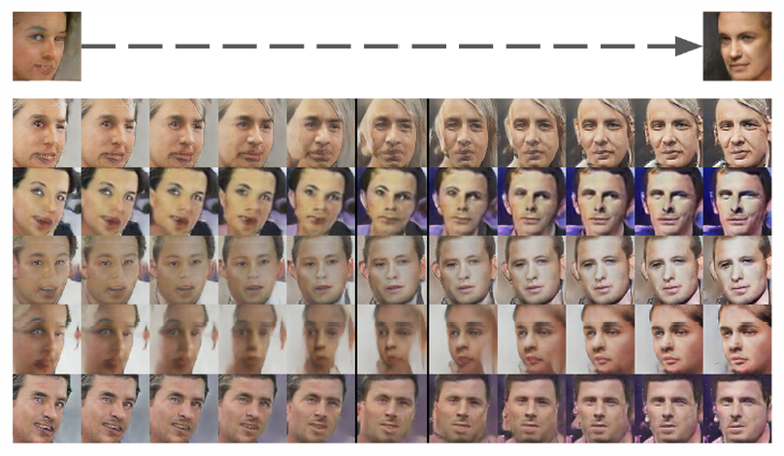
Experiments

Slide 25
Generative Adversarial Text to Image Synthesis, ICML 2016.
Slide credit: Sangdoo Yun @PIL (pil.snu.ac.kr)
Scott Reed*, Zeynep Akata**, Xinchen Yan*, Lajanugen Logeswaran*, Bernt Schiele**, Honglak Lee*
* University of Michigan, Ann Arbor, MI, USA (UMICH.EDU)
** Max Planck Institute for Informatics, Saarbrucken, Germany (MPI-INF.MPG.DE)

Slide 26
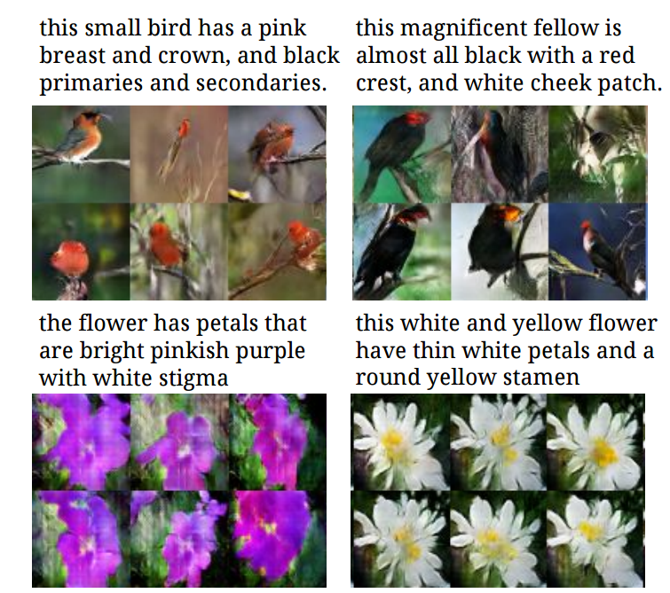
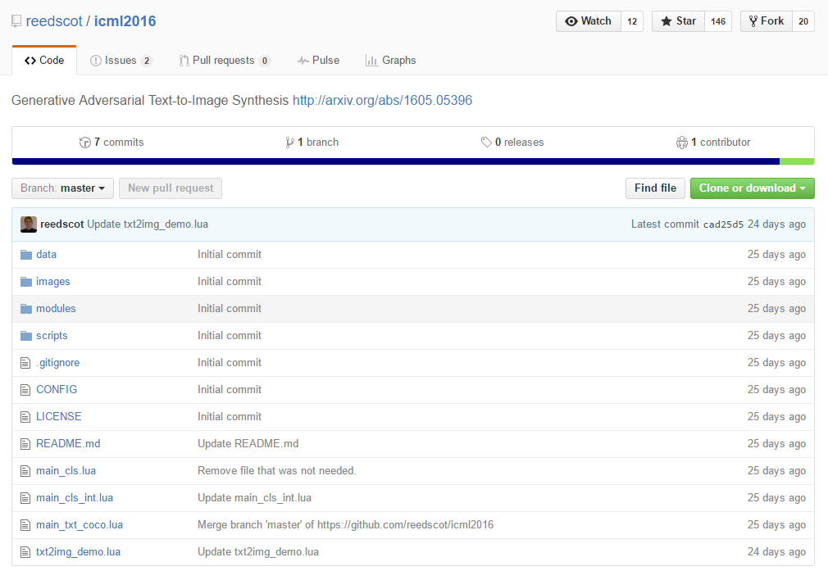
Generative Adversarial Text to Image Synthesis

Slide 27
Generative model
What I cannot create, I do not understand —Richard Feynman
Generating images
Image data (e.g. ImageNet): samples from the true data distribution.
Generative model (e.g. deep neural network): outputs images, which means samples from the model.

Slide 28
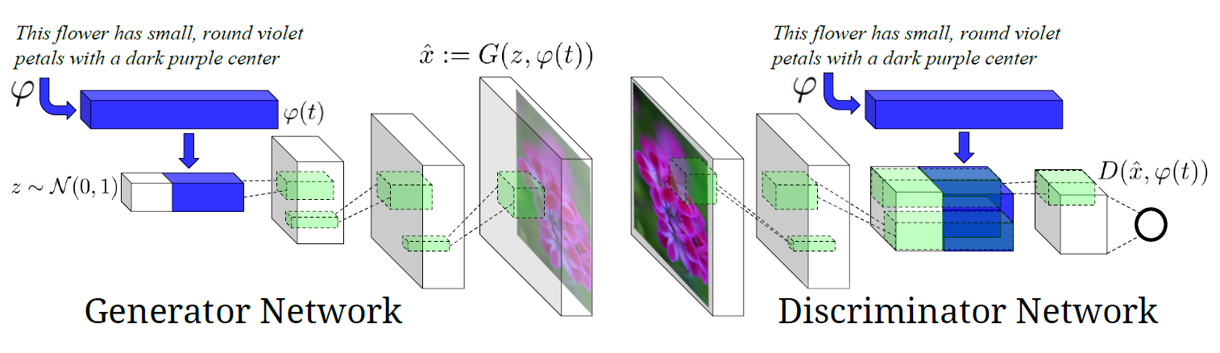
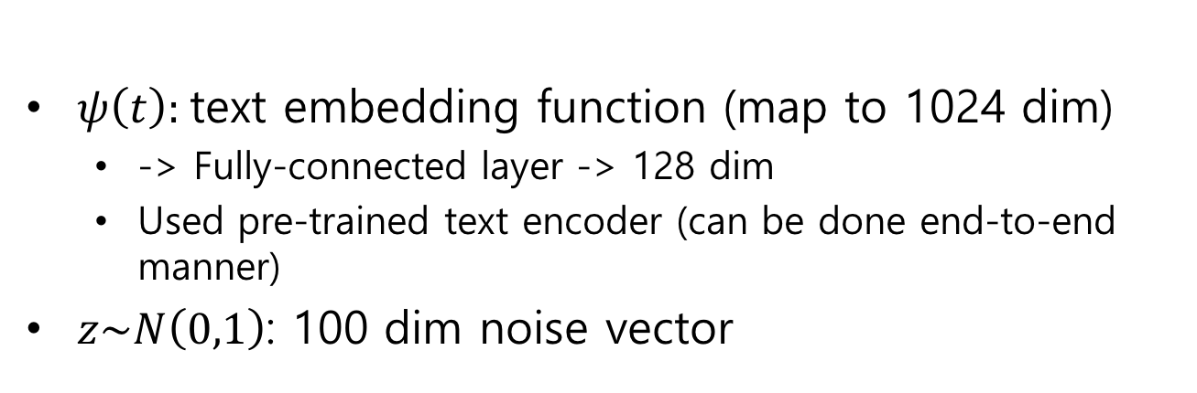
GAN – text to image synthesis
$ψ\left(t\right):$text embedding function (map to 1024 dim)
-> Fully-connected layer -> 128 dim
Used pre-trained text encoder (can be done end-to-end manner)
$z\sim N\left(0,1\right)$: 100 dim noise vector
Text-Conditional GAN

Slide 29
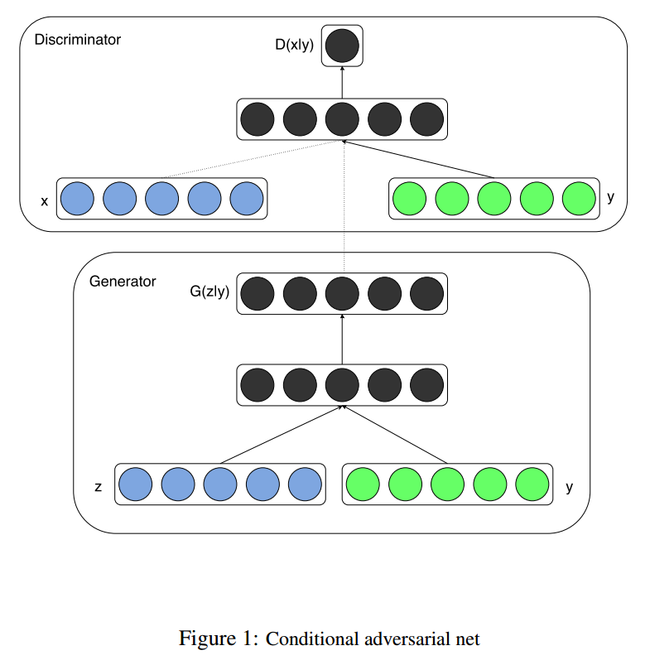
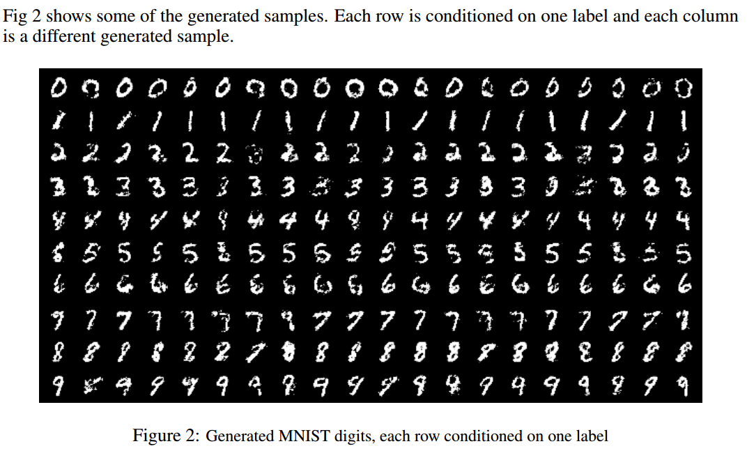
Conditional GAN
Mirza, Mehdi, and Simon Osindero. "Conditional generative adversarial nets."arXiv preprint arXiv:1411.1784 (2014).

Slide 30
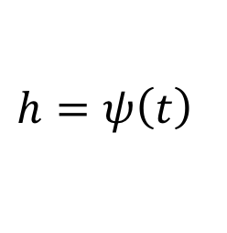
Text-conditional GAN (naïve)
128 dim
4*4*16
Real image & matched text
Fake image & arbitrary text
$$h=ψ\left(t\right)$$
$$\min_{G}{\max_{D}{E_{x\sim p_{data}}\left[\log\left(D\left(x,h\right)\right)\right]+E_{z\sim p_{z}}\left[\log\left(1−D\left(G\left(z,\hat{h}\right),\hat{h}\right)\right)\right]}}$$

Slide 31
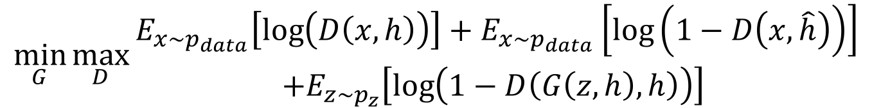
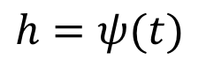
Matching-aware discriminator
128 dim
4*4*16
Real image & matched text
Real image & mismatched text
$$h=ψ(t)$$
$$\min_{G}{\max_{D}{\begin{aligned}E_{x\sim p_{data}}\left[\log\left(D\left(x,h\right)\right)\right]+E_{x\sim p_{data}}\left[\log\left(1−D\left(x, \hat{h}\right)\right)\right] \\ +E_{z\sim p_{z}}\left[\log\left(1−D\left(G\left(z,h\right),h\right)\right)\right] \end{aligned}}}$$
Fake image & matched text

Slide 32
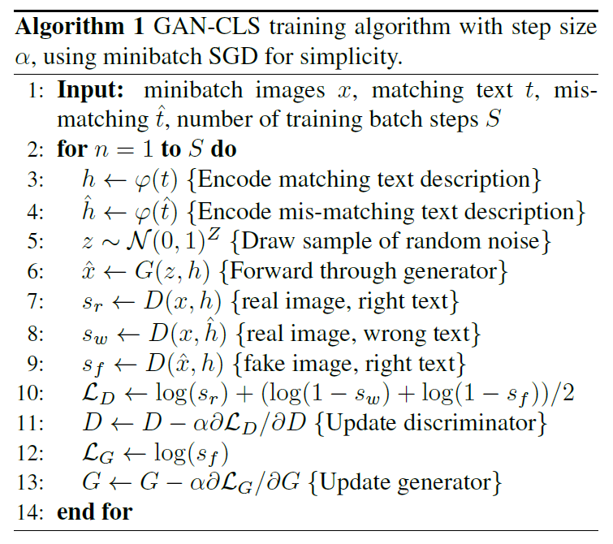
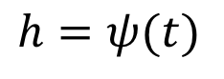
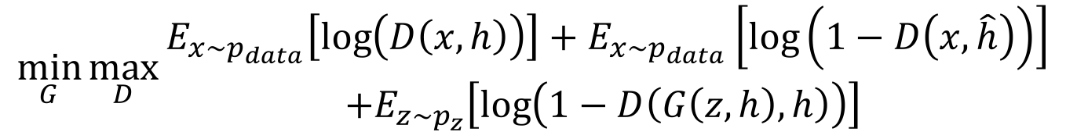
Matching-aware Discriminator
Real image & matched text
Real image & mismatched text
$$h=ψ(t)$$
$$\min_{G}{\max_{D}{\begin{aligned}E_{x\sim p_{data}}\left[\log\left(D\left(x,h\right)\right)\right]+E_{x\sim p_{data}}\left[\log\left(1−D\left(x, \hat{h}\right)\right)\right] \\ +E_{z\sim p_{z}}\left[\log\left(1−D\left(G\left(z,h\right),h\right)\right)\right] \end{aligned}}}$$
Fake image & matched text

Slide 33
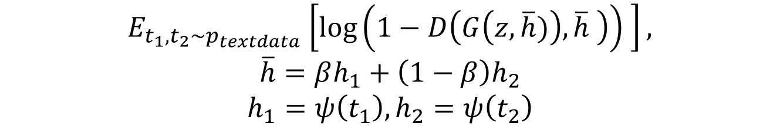
Learning with Manifold Interpolation
Real image & matched text
Real image & mis-matched text
$$h=ψ(t)$$
$$\min_{G}{\max_{D}{\begin{aligned}E_{x\sim p_{data}}\left[\log\left(D\left(x,h\right)\right)\right]+E_{x\sim p_{data}}\left[\log\left(1−D\left(x, \hat{h}\right)\right)\right] \\ +E_{z\sim p_{z}}\left[\log\left(1−D\left(G\left(z,h\right),h\right)\right)\right] \end{aligned}}}$$
Fake image & matched text
Additional term to generator to minimize:
$E_{t_{1},t_{2}\sim p_{textdata}}\left[\log\left(1−D\left(G\left(z,\overline{h})\right),\overline{h} \right)\right) \right],$
$$\overline{h}=βh_{1}+\left(1−β\right)h_{2}$$
$$h_{1}=ψ\left(t_{1}\right), h_{2}=ψ\left(t_{2}\right)$$

Slide 34
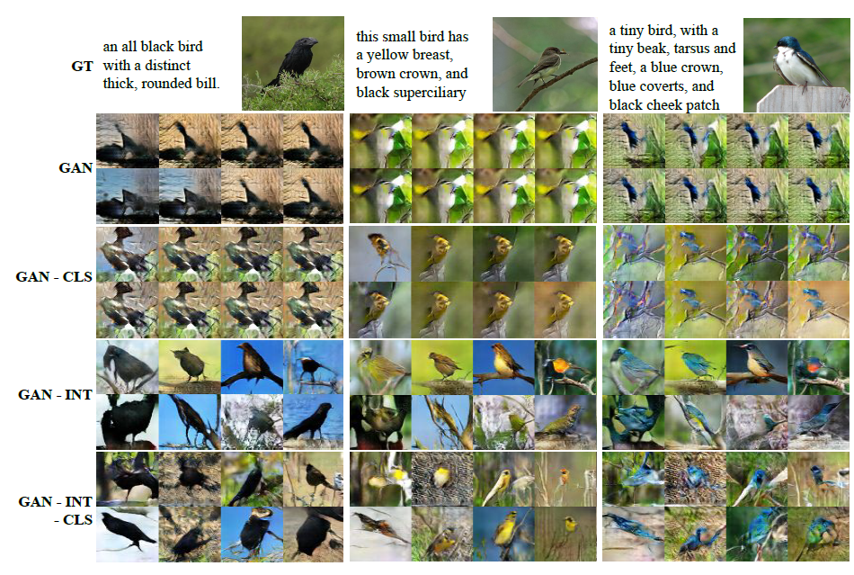
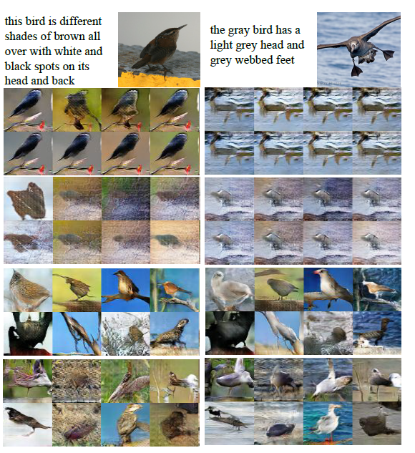
Experiments

Slide 35
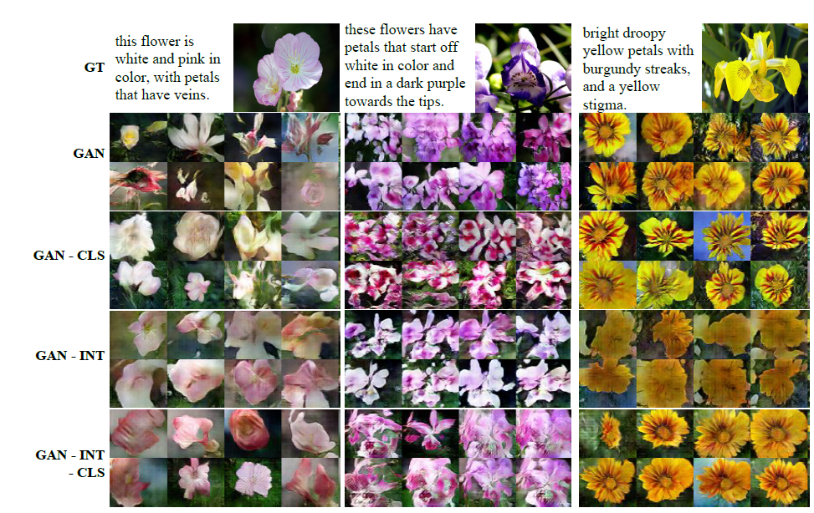
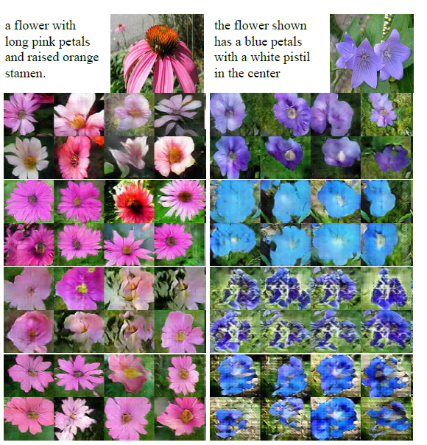
Experiments

Slide 36

Style Transfer
128 dim
4*4*16
$$L_{style}=E_{t,z\sim N\left(0,1\right)}{\left\|z−S\left(G\left(z,h\right)\right)\right\|}_{2}^{2}$$
$$S\left(x\right)→z$$
Finding an inverse mapping from an image to vector

Slide 37



Style Transfer
$$L_{style}=E_{t,z\sim N\left(0,1\right)}{\left\|z−S\left(G\left(z,h\right)\right)\right\|}_{2}^{2}$$
$$S\left(x\right)→z$$
Input image: $x$
Style: $z = S(x)$
Generated image: $G(z,h)$
Image
Style vector
Style transferred image
Text description

Slide 38

Sentence Interpolation

Slide 39

Pixel Level Domain Transfer, ECCV 2016.

Slide 40

Domain transfer

Slide 41

Whole architecture
Converter: deconvnet
Discriminator: Real vs. Fake
Discriminator : Associated or not

Slide 42

Dataset

Slide 43

Results

Slide 44

Results – varying input conditions

Slide 45

Results – inverse setting

Slide 46

Image to Image Translation
Image-to-Image Translation with Conditional Adversarial Networks

Slide 47


Image to Image Translation
+ L1 loss function
Low-freq correctness
+ PatchGAN
High-freq correctness

Slide 48




Image to Image Translation

Slide 49




Image to Image Translation

Slide 50

Plug & Play Generative Networks ArXiv 2016.

Slide 51


Plug & Play Generative Networks

Slide 52

Plug & Play Generative Networks

Slide 53








Noiseless joint PPGN-h
Update Rule for a feature vector h
Training G
Training D

Slide 54

Noiseless joint PPGN-h
Encoder network is pre-trained.
G and D are trained with standard GAN learning technique.
G is not directly used to generate image, but used as a guiding function combined with DAE.

Slide 55

PPGN results

Slide 56

PPGN results

Slide 57

Learning What and Where to Draw NIPS 2016.

Slide 58

Motivation
Generative adversarial what-where nets (GAWWN)
Give a bbox
Give part locations
Give a part location

Slide 59

Bounding Box Control
Generator input: z, text, bbox location

Slide 60

Bounding Box Control
Discriminator input: real/fake image, text, bbox location

Slide 61

Bounding Box Control
Overall structure

Slide 62

Keypoint-Conditional Control
Generator input: z, text, keypoint location
(e.g., head in channel 1, left foot in channel 2, …)

Slide 63

Keypoint-Conditional Control
Discriminator input: real/fake image, text, keypoint location

Slide 64

Keypoint-Conditional Control
Overall structure

Slide 65

Experiments
Bbox control (fix text and z / varying bbox)

Slide 66


Experiments
Keypoint control (fix text / use gt keypoints / varying z)
Keypoint control (fix text and z / varying beak and tail keypoint positions and
generate other keypoints conditionally)

Slide 67


Experiments
Keypoint control (fix text and z / generate all keypoints conditioned on text)

Slide 68


